Slide 1
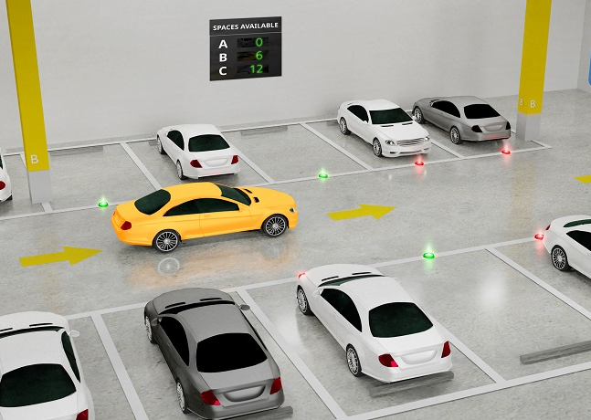
Smart Car Park for Optimal Operation
Give your project a catchy title. Include the names of all the group members.
To Toh Nau
Sing Song Lah
Garfield Cat

Slide 2
“Academic” Style Presentation
Background
Objective
System Design
Methods
Implementation Details
Results
Discussion
Conclusion
Create a table of content slide that gives your audience an idea of the flow of your presentation.

Slide 3
Content
You are encouraged to follow this outline instead.
Use it to “pitch”, i.e. sell, your idea.
Motivation
Introduction
Project Design & Methodology
Project Value Proposition
Conclusion

Slide 4
Motivation
How can we as an engineer develop a connected system to create a green, liveable and sustainable environment for better future?
Explain what motivates your team and how the team arrives at the project idea that fulfils the needs of the driving question.

Slide 5
Introduction
Give a high-level explanation of your project by clearly listing the criteria and constraints of your project.
Zoom in to the features implemented in the project that can justify its existence in answering the driving question.

Slide 6

Project Design & Methodology
Give a high-level overview of your project implementation. Articulate the design process and method used in developing or designing the project. Pick one or two parts that is unique to your project to discuss in more detail.
Use at least one picture/diagram to explain your project implementation.
Avoid using source code to describe your project implementation.

Slide 7
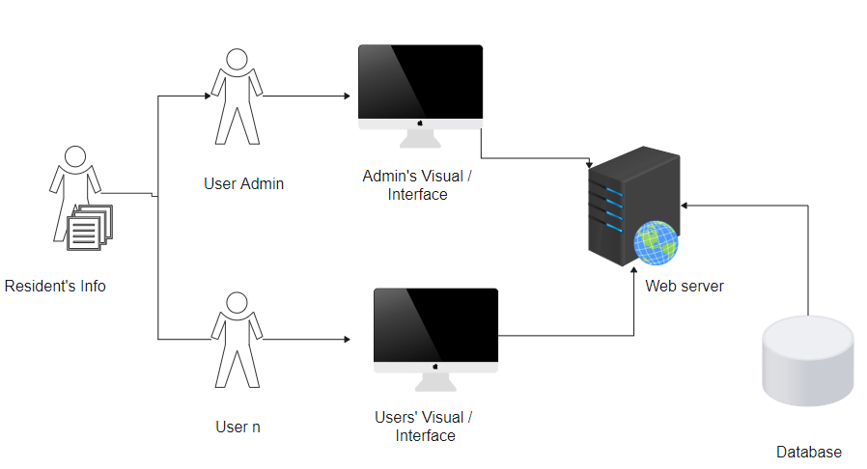
(For example only)

Slide 8

Project Value Proposition
Describes what separates your project from your competitors, i.e. its uniqueness.
It could include how your project solves your customers’ problem, the specific benefits, and why your target customers should choose you over the competition.

Slide 9
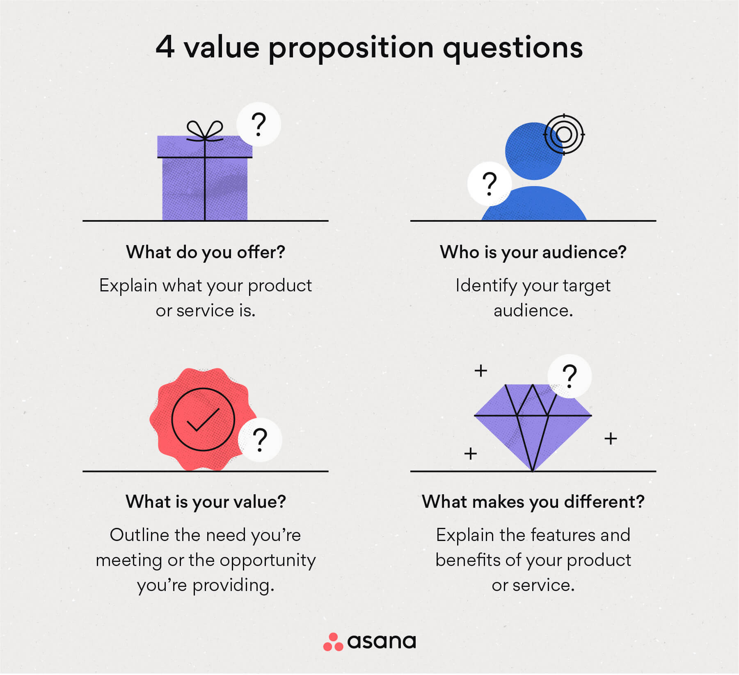

Slide 10

Conclusion
Discuss lessons learned in this project.
Discuss what was difficult? What do you wish you could have done (or done differently)?
What would change if you have more time?

